Slide 1
Digital Signal Processing(BEC-303)
Unit-1
Lecture-6
Presented By:
Dr. Ishwar Chandra Yadav

Slide 2
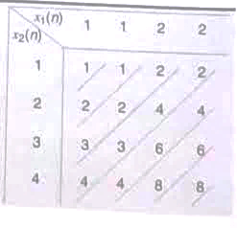
Example: Compute (a) linear and (b) circular periodic convolutions of the two sequences x₁ (n) ={1, 1,2,2} and x₂(n)={1,2,3,4}. (c) Also find circular convolution using the DFT and IDFT.
Solution:
(a)Using matrix representation given as follows, the linear convolution of the two sequences can be determined.
Hence, x₃(n) = x₁(n)*x₂(n) ={1,3,7,13,14,14,8}
(b)Similarly, circular convolution of the two sequences is shown in Fig. E6, 15.

Slide 3
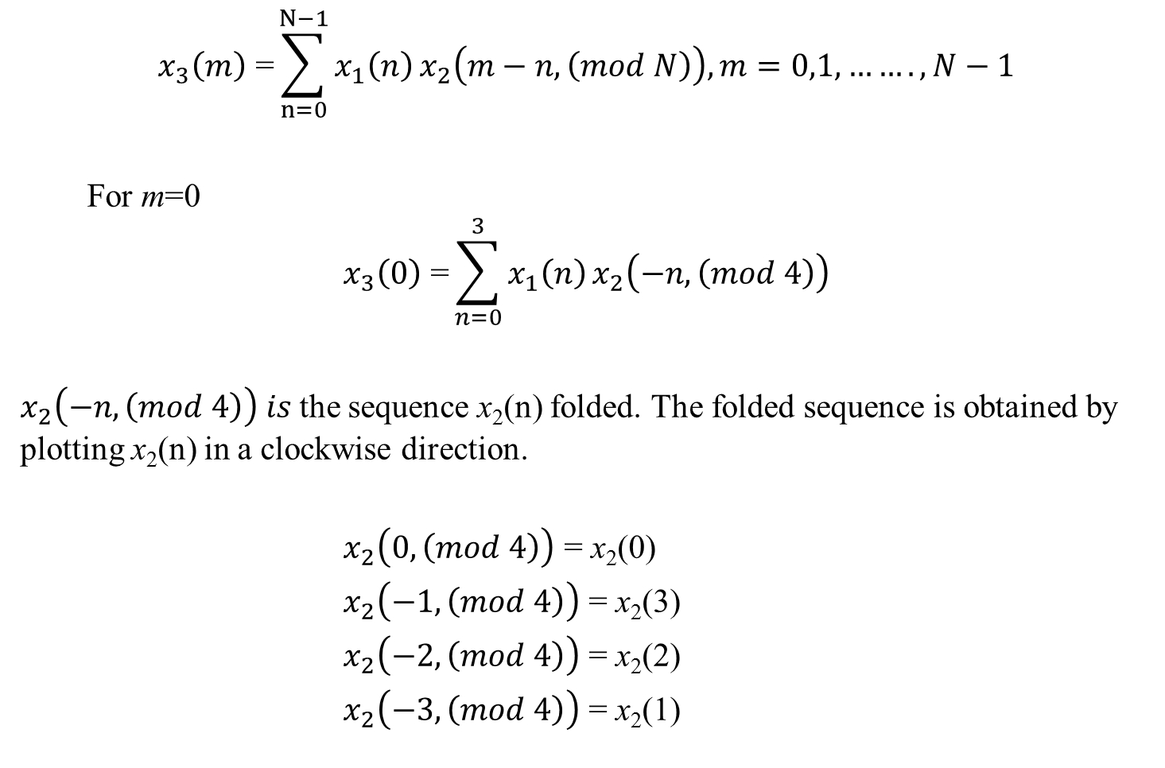
$$x_{3}\left(m\right)\text{ =}\sum_{n=0}^{N−1}{x_{1}\left(n\right)}x_{2}\left(m−n,\left(mod N\right)\right), m=0,1,…….,N−1$$
For m=0
$$x_{3}\left(0\right)\text{ =}\sum_{n=0}^{3}{x_{1}\left(n\right)}x_{2}\left(−n,\left(mod 4\right)\right)$$
$x_{2}\left(−n,\left(mod 4\right)\right) is$the sequence x₂(n) folded. The folded sequence is obtained by plotting x₂(n) in a clockwise direction.
$x_{2}\left(0,\left(mod 4\right)\right)$ = x₂(0)
$x_{2}\left(−1,\left(mod 4\right)\right)$ = x₂(3)
$x_{2}\left(−2,\left(mod 4\right)\right)$ = x₂(2)
$x_{2}\left(−3,\left(mod 4\right)\right)$ = x₂(1)

Slide 4
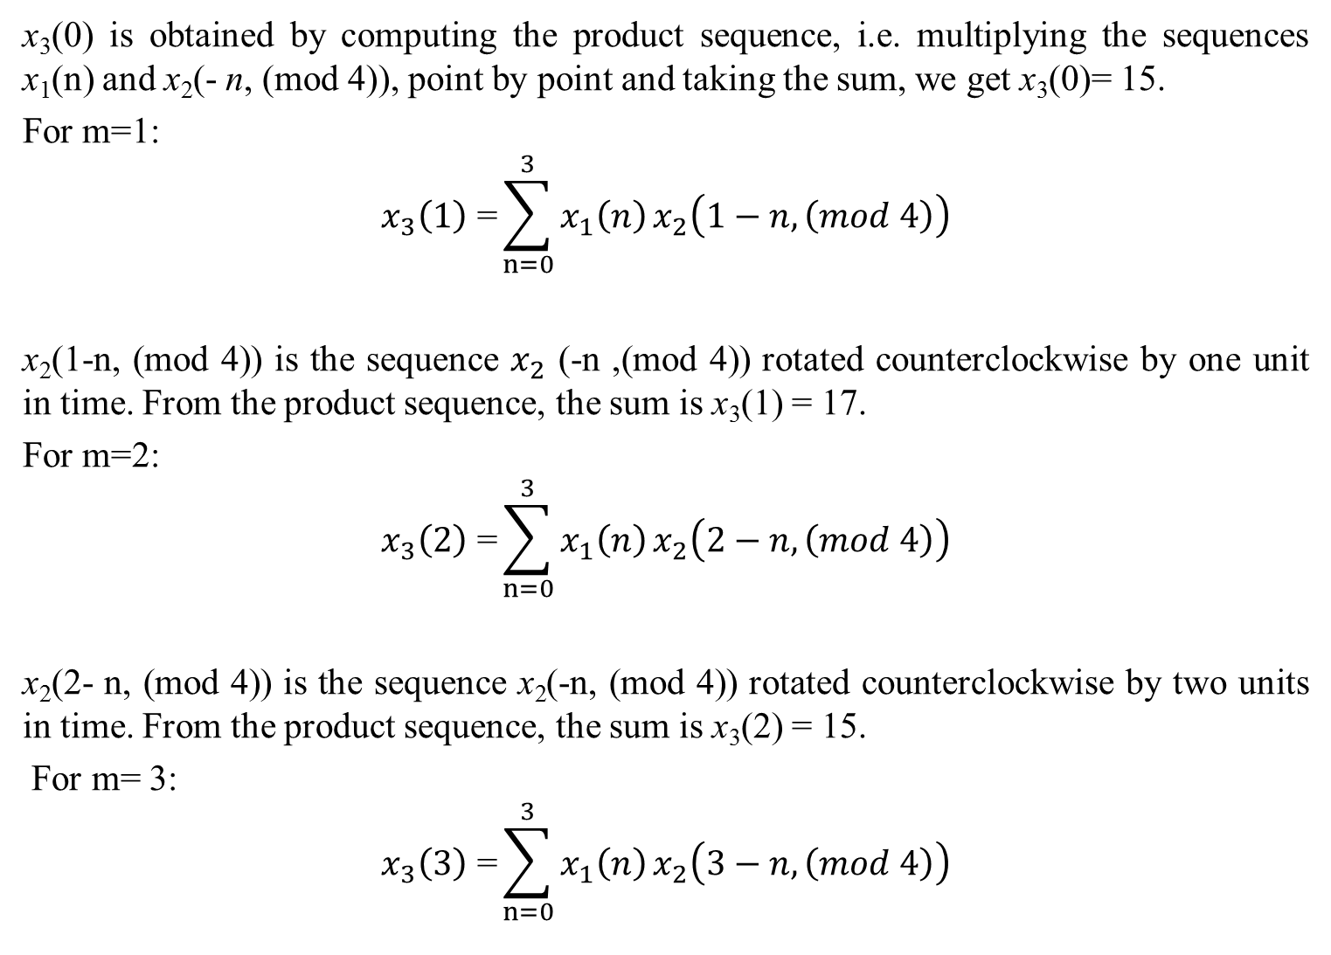
x₃(0) is obtained by computing the product sequence, i.e. multiplying the sequences x₁(n) and x₂(- n, (mod 4)), point by point and taking the sum, we get x₃(0)= 15.
For m=1:
$$x_{3}\left(1\right)\text{ =}\sum_{n=0}^{3}{x_{1}\left(n\right)}x_{2}\left(1−n,\left(mod 4\right)\right)$$
x₂(1-n, (mod 4)) is the sequence $x_{2}$ (-n ,(mod 4)) rotated counterclockwise by one unit in time. From the product sequence, the sum is x₃(1) = 17.
For m=2:
$$x_{3}\left(2\right)\text{ =}\sum_{n=0}^{3}{x_{1}\left(n\right)}x_{2}\left(2−n,\left(mod 4\right)\right)$$
x₂(2- n, (mod 4)) is the sequence x₂(-n, (mod 4)) rotated counterclockwise by two units in time. From the product sequence, the sum is x₃(2) = 15.
For m= 3:
$$x_{3}\left(3\right)\text{ =}\sum_{n=0}^{3}{x_{1}\left(n\right)}x_{2}\left(3−n,\left(mod 4\right)\right)$$

Slide 5
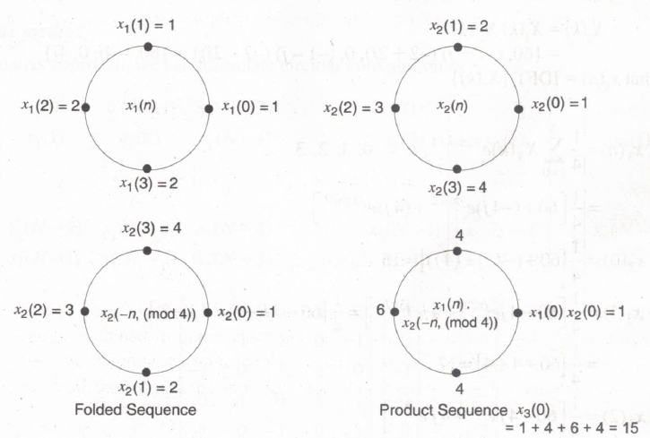
x(3- n,(mod 4)) is the sequence x₂(- n, (mod 4)) rotated counterclockwise by three units in time, From the product sequence, the sum is x₃(3) = 13.
Hence, the circular convolution of the two sequences x₁(n) and x₂(n) is
x₃(n)= {15,17,15,13}

Slide 6
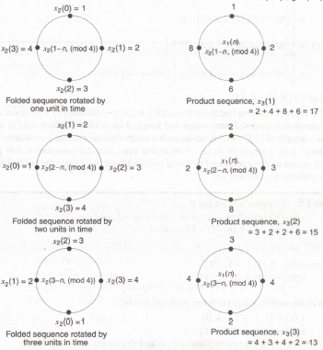

Slide 7

(c) Here the DFT and IDFT are used for finding circular convolution
X₃(k)= X₁(k) X₂ (k)
And
$$\text{x}\text{3}\text{(}\text{n}\text{) = }\frac{1}{N}\sum_{k=0}^{N−1}{X_{3}}\left(k\right)e^{\frac{2jπk}{N}}\text{ , }\text{n}\text{=0,1,….,}\text{N}\text{−1}$$
(i)When x₁(n) = [1, 1, 2, 2]
$$\text{X}\text{1}\text{(}\text{k}\text{) =}\sum_{n=0}^{N−1}{x_{1}}(n)e^{\frac{−2jπnk}{N}}\text{, }\text{k}\text{=0,1,….,}\text{N}\text{−1}$$
For N=4
$$\text{X}\text{1}\text{(}\text{k}\text{) =}\sum_{n=0}^{3}{x_{1}}(n)e^{\frac{−2jπnk}{4}}\text{, }\text{k}\text{=0,1,23}$$
For k=0
$$\text{X}\text{1}\text{(0) =}\sum_{n=0}^{3}{x_{1}}\left(n\right)e^{\frac{−2jπn\left(0\right)}{4}}=6$$
For k=1
$$\text{X}\text{1}\text{(1) =}\sum_{n=0}^{3}{x_{1}(n)e^{\frac{−jπn}{2}}}$$

Slide 8

=1+$e^{\frac{−jπ}{2}}$+2$e^{−jπ}+2e^{\frac{−j3π}{2}}$= 1- j+2(-1) + 2(j)= -1 + j
For k=2
$$\text{X}\text{1}\text{(2) =}\sum_{n=0}^{3}{x_{1}}(n)e^{−jnπ}$$
= 1+${ e}^{−jπ} +$2$e^{−2π}+2e^{−j3π}$=1 - 1 + 2 (1) + 2 (-1)=0
For k=3
$$\text{X}\text{1}\text{(1) =}\sum_{n=0}^{3}{x_{1}}\left(n\right)e^{−j3nπ/2}$$
= 1+${ e}^{−j3π/2}$+ 2$e^{−j3π}+2e^{−jn/2}$ = 1+ j+2 (-1) – j (2) = -1- j
$$X_{1}\left(k\right)=\{6,−1+j,0,−1−j\}$$
(ii) When x₂(n) = {1, 2, 3,4}
Here, N=4. Therefore,
$$\text{X}\text{2}\text{(}\text{k}\text{) =}\sum_{n=0}^{3}{x_{2}}(n)e^{\frac{−2jπnk}{4}}\text{, }\text{k}\text{=0,1,2,3}$$

Slide 9

For k=0
$$\text{X}\text{2}\text{(0) = }\sum_{n=0}^{3}{x_{2}\left(n\right)e^{\frac{−2jπn\left(0\right)}{4}}=10}$$
For k=1
$$X_{2}\text{(1) =}\sum_{n=0}^{3}{x_{2}(n)e^{\frac{−jπn}{2}}}$$
=1+$2e^{\frac{−jπ}{2}}$ + 3$e^{−jπ}+4e^{\frac{−j3π}{2}}$=1 + 2 (-j)+ 3 (-1) + 4(j) = -2 + j2
For k=2
$$\text{X}\text{2}\text{(2) =}\sum_{n=0}^{3}{x_{2}(n)e^{−jnπ}}$$
= 1 + $2e^{−jπ}$+ 3$e^{−jπ}+4e^{−j3π }$= 1+ 2(-1) + 3(1) + 4(-1)= -2
For k=3
$$X_{2}\text{(3) =}\sum_{n=0}^{3}{x_{2}}\left(n\right)e^{−j\left(\frac{3π}{2}\right)n}$$
= 1+${2e}^{−j3π/2}$+3$e^{−j3π}+4e^{−j9π/2}$ = 1+2(j)+3(-1)+4(-j) = -2-2j
X₂(k)={10,-2+2j, -2, -2 -2j}

Slide 10
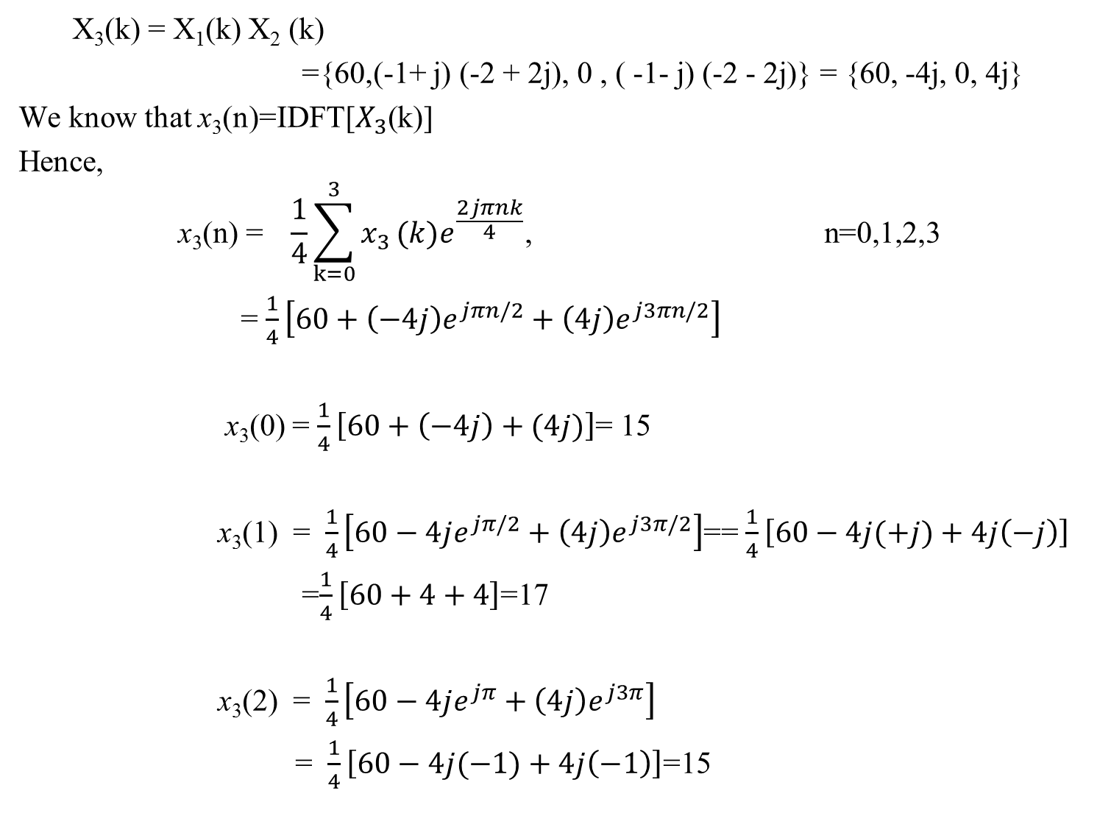
X₃(k) = X₁(k) X₂ (k)
={60,(-1+ j) (-2 + 2j), 0 , ( -1- j) (-2 - 2j)} = {60, -4j, 0, 4j}
We know that x₃(n)=IDFT[$X_{3}$(k)]
Hence,
$$\text{x}\text{3}\text{(}\text{n}\text{) = }\frac{1}{4}\sum_{k=0}^{3}{x_{3}}(k)e^{\frac{2jπnk}{4}}\text{,} \text{n}\text{=0,1,} \text{2,3}$$
= $\frac{1}{4}\left[60+\left(−4j\right)e^{jπn/2}+\left(4j\right)e^{j3πn/2}\right]$
x₃(0) = $\frac{1}{4}\left[60+\left(−4j\right)+(4j)\right]$= 15
x₃(1) = $\frac{1}{4}\left[60−4je^{jπ/2}+\left(4j\right)e^{j3π/2}\right]$== $\frac{1}{4}\left[60−4j(+j)+4j\left(−j\right)\right]$
=$\frac{1}{4}\left[60+4+4\right]$=17
x₃(2) = $\frac{1}{4}\left[60−4je^{jπ}+\left(4j\right)e^{j3π}\right]$
= $\frac{1}{4}\left[60−4j(−1)+4j\left(−1\right)\right]$=15

Slide 11

X₃(3) = $\frac{1}{4}\left[60−(4j{)e}^{j3π/2}+\left(4j\right)e^{j9π/2}\right]$
= $\frac{1}{4}\left[60+4j(−4j)(−j)+4j\left(−j\right)\right]$
=$\frac{1}{4}\left[60−4−4\right]$=13
Therefore, x₃ (n) = {15,17,15,13}

